Slide 1


Holidays

Slide 2


Slide 3


Slide 4


Slide 5
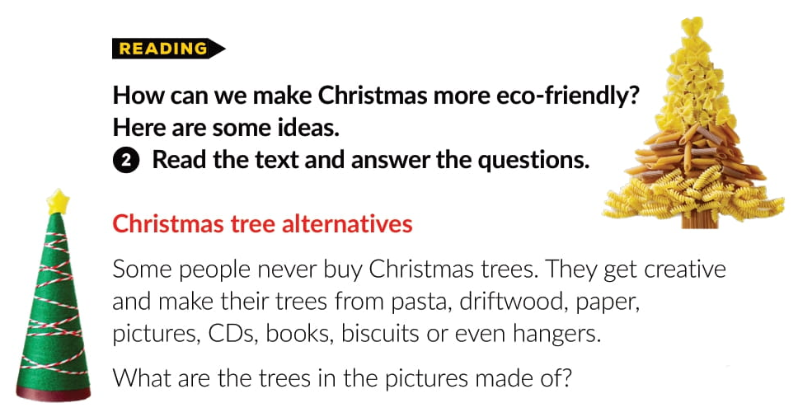

Slide 6
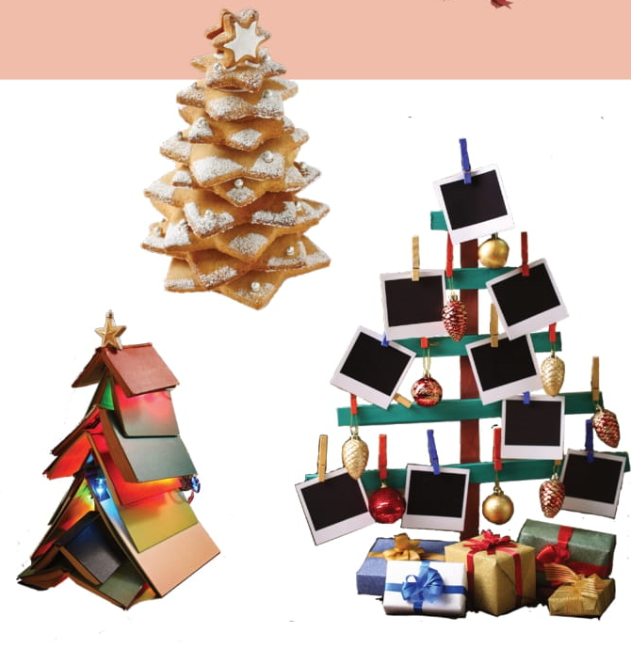

Slide 7


Slide 8
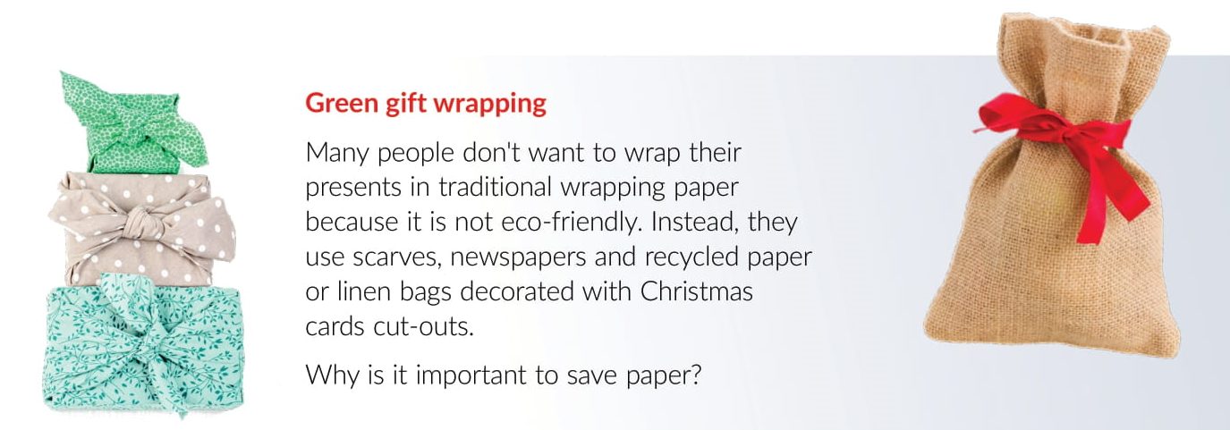

Slide 9

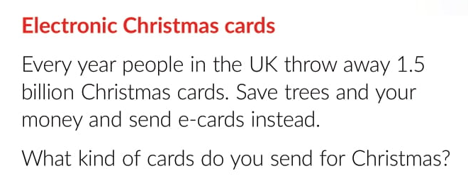
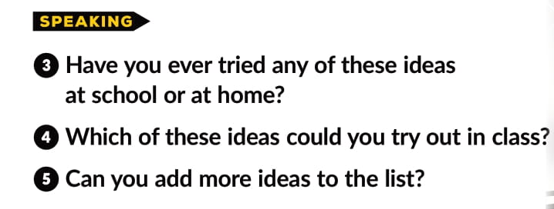

Slide 10
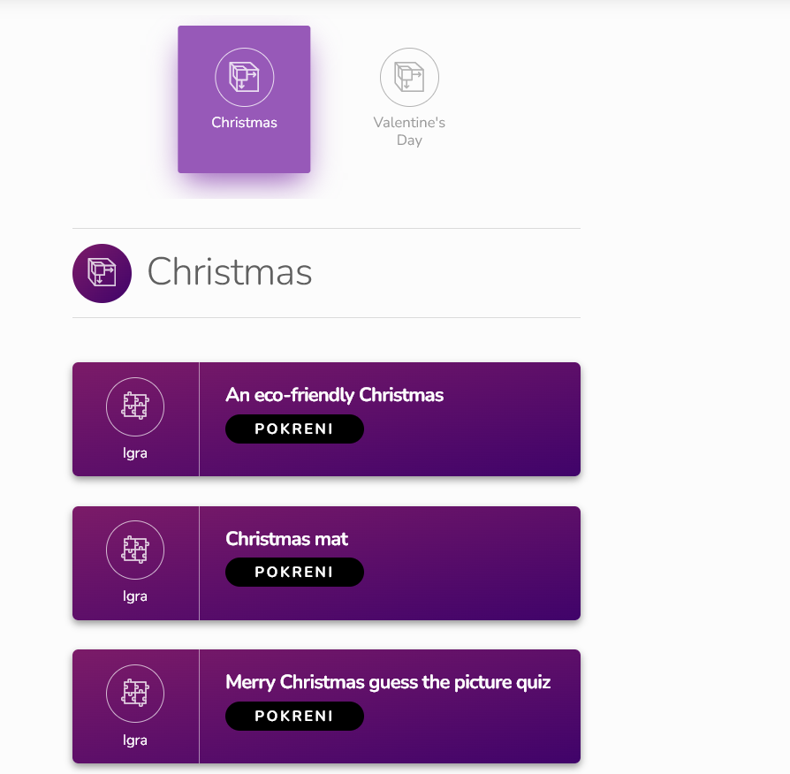
Extra pages -Holidays | Way to go 3 (e-sfera.hr)

